Slide 1

Air Pollution Leads To DEATH?
December 4, 2019
Tram Nghi Pham, Brandon Pratt, Siting Wang,
and Marta Wolfshorndl

Slide 2

Presentation Outline
Problem Statement
Data Overview
Use Cases
Demo of Map
Design Components
Github Repo Structure
Notes:
Siting

Slide 3

Problem Statement
Air pollution is an increasing concern across the globe as it has been linked to the development of respiratory illnesses, including asthma, cancer, and others
An interactive platform for the public to visualize and predict the relationship between geographic respiratory death rates in the United States and air pollution does not exist.
Notes:
Siting

Slide 4

Our Aim
We aim to develop such a tool in order to illustrate:
How the air quality index (AQI) correlates with geographic respiratory death rates in the United States
If we could predict respiratory death rates given prior and current pollution levels.
Notes:
Siting

Slide 5

Data Overview
United State Environmental Protection Agency (Air Pollution)
https://aqs.epa.gov/aqsweb/airdata/download_files.html#AQI
Centers for Disease and Control for Prevention (Death Rate)
https://www.nber.org/data/vital-statistics-mortality-data-multiple-cause-of-death.html
Notes:
Tram

Slide 6
Data Overview
~ 5M rows
From 2000-2017
Air Pollution
Dataset
Air Quality Index
State Name
County Name
Date + Time
Dataset
From 2000 - 2017
~ 2M rows/year
Death Rate Dataset
Rates of death
State Name
County Name
Month and Year
Notes:
Tram

Slide 7
Data Limitations
Air pollution and respiratory death data is only available for 1,086 counties out of the 3,007 U.S. counties.
The data is only available for the past 15 years.
Time resolution is different for the respiratory death (monthly) and the air pollution data (reported on every 3 days).
Data files contained data for each year, and therefore, required concatenating the data across all years.
County codes had to be converted into strings so that it contained a leading zero.
Both data sets did not have the same geographical information required for relating the data to counties.
Many NaN values
Notes:
Tram

Slide 8
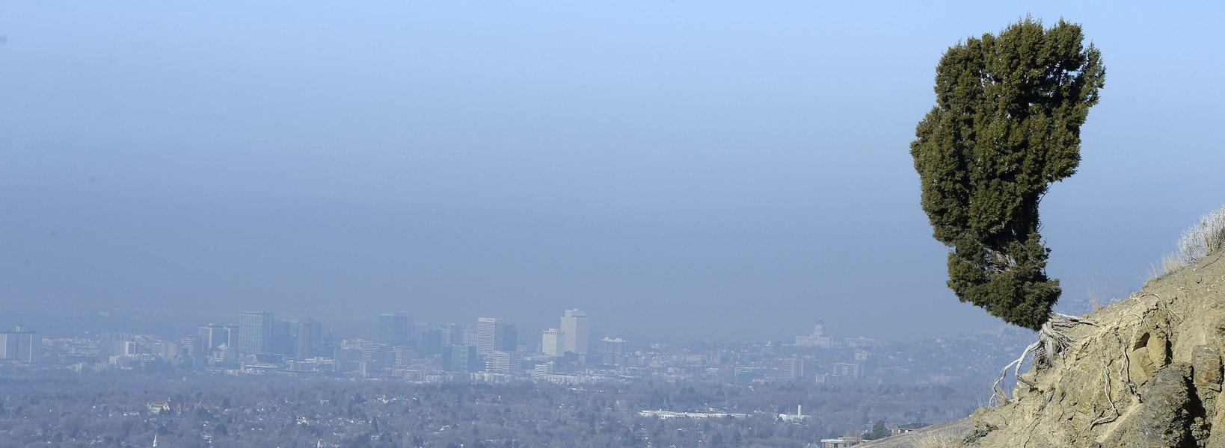
Use Cases
Objective of user interaction: For a user to visualize the correlation between respiratory death rate and air pollution for a desired U.S. county and to receive a predicted respiratory illness risk factor for that county.
Notes:
Marta

Slide 9
Use Cases ①
Objective of user interaction: For a user to visualize the correlation between respiratory death rate and air pollution for a desired U.S. county and to receive a predicted respiratory illness risk factor for that county.
The expected interaction between the user (any public citizens) and our system:
The user chooses a county from an interactive map.
Two graphs displaying the respiratory death rate and air pollution over time appear.
A predicted risk factor is displayed.
Individual makes decision based on risk factor (i.e. wear a mask).
Notes:
Marta

Slide 10
Use Cases ②
Public Health Researcher:
The objective is to test a type of method to reduce the impact of the air pollution. Areas that have poor air quality and high death rate correlation coefficients will be the ideal place for the study.
The researchers find counties with the greatest risk by using our system by screening the data according to their specification. They go there to test the medical method and monitor the respiratory death rates.
Notes:
Marta

Slide 11

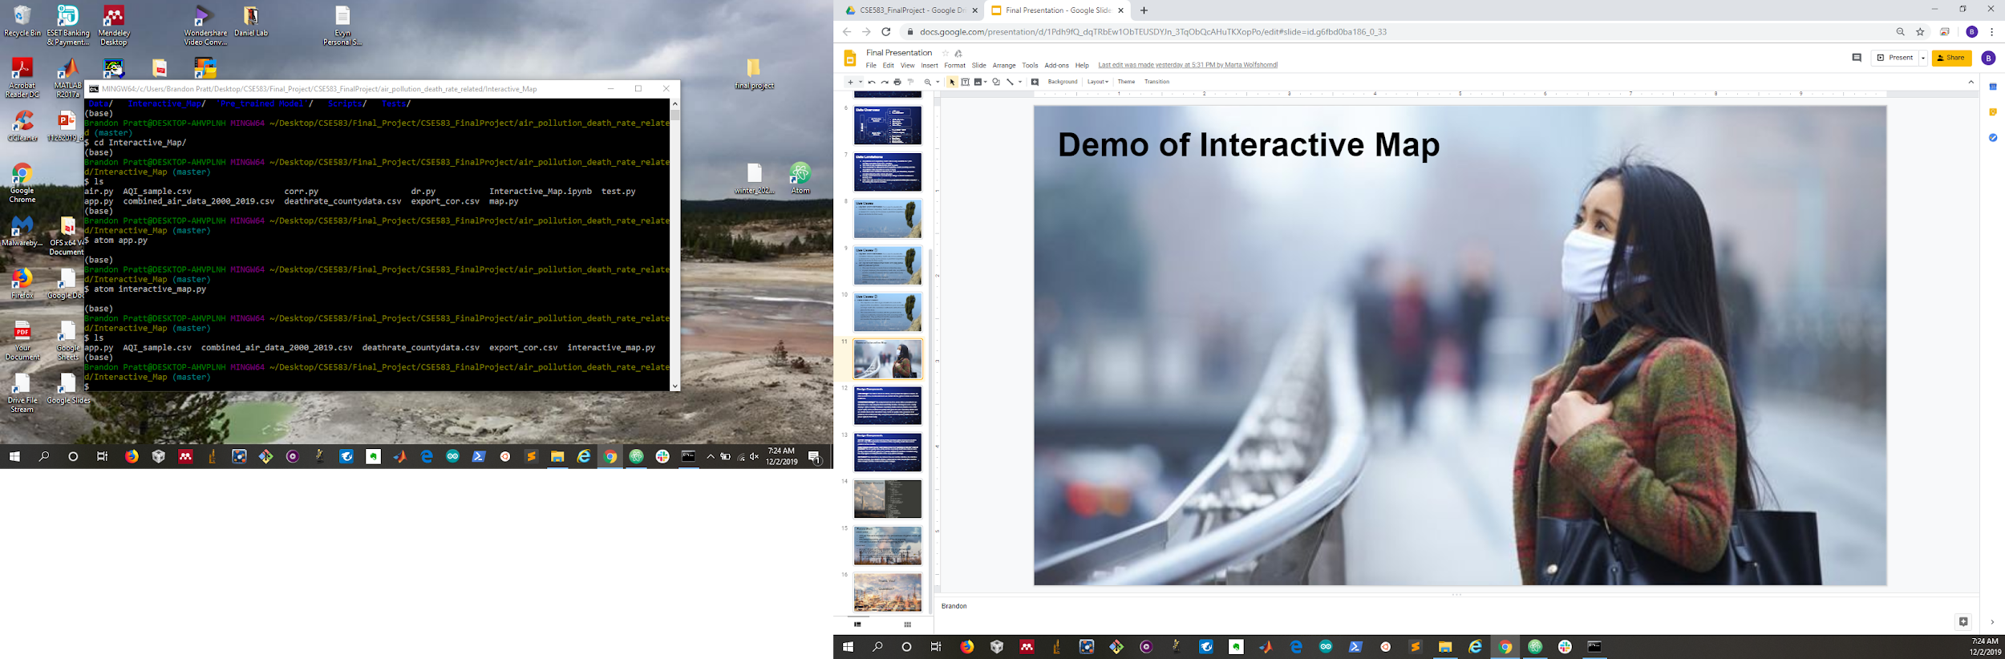

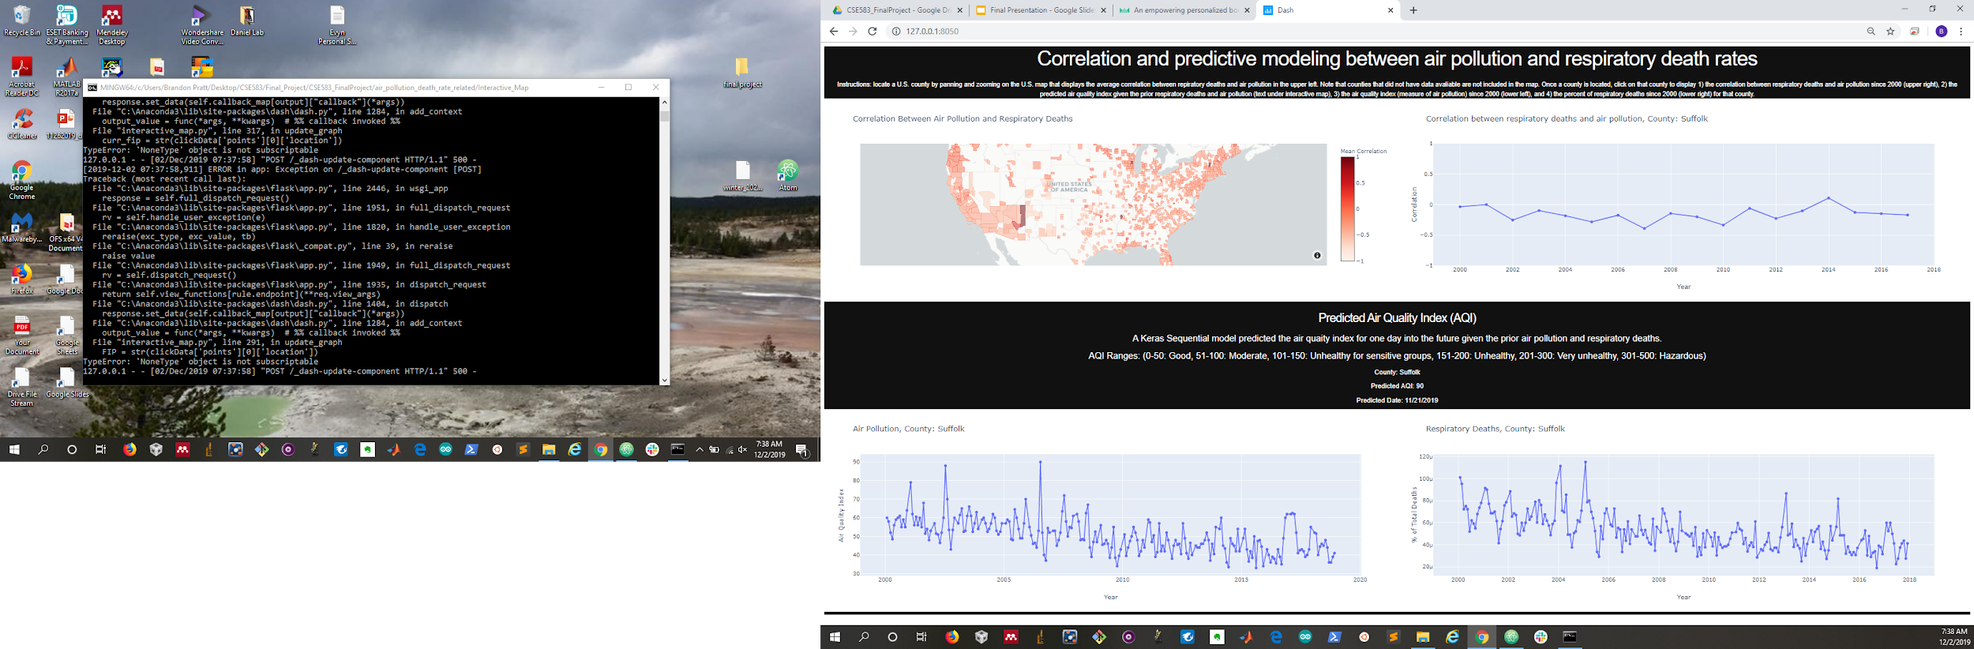
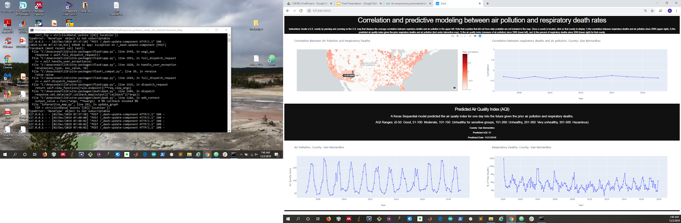
Demo of Interactive Map
Go to the Interactive_Map Directory:
In the command terminal run “python interactive_map.py”:
Click on a U.S. county on the interactive map in the upper left to display the associated time series data:
Copy html link into the browser:
Notes:
Brandon

Slide 12
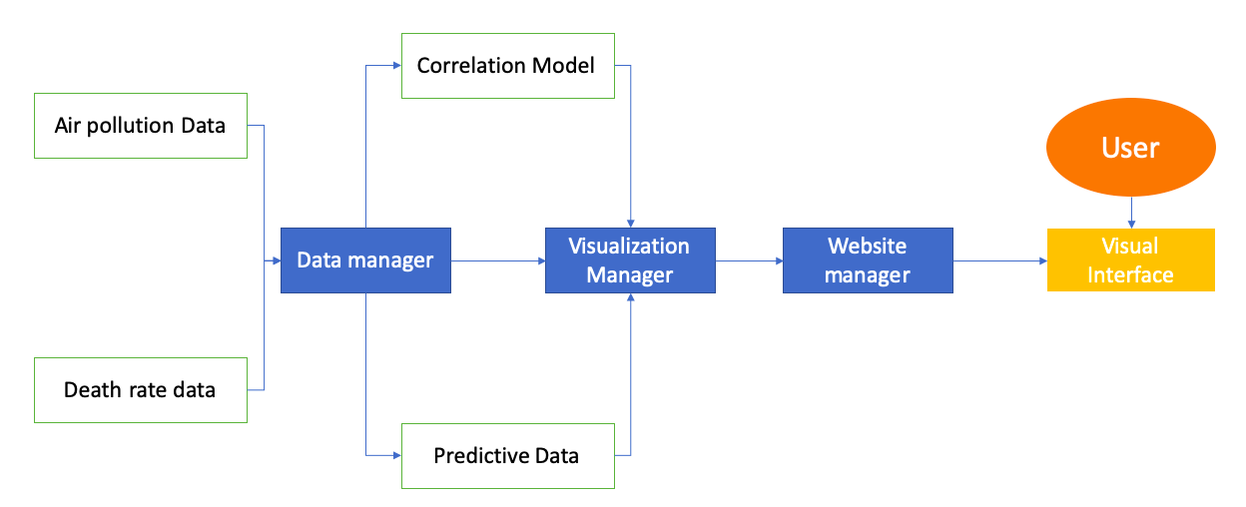
Design Components Flowchart
Notes:
Tram

Slide 13
Design Components
Data Manager: Our data is stored on Github, and imported into Python modules. All data needed to be concatenated and was loaded into the python module as a Pandas Dataframe.
Visualization Manager: The analyzed and raw time series data is presented in an interactive U.S. map using the Dash and Plotly libraries. Clicking on a U.S. county displays: 1) the correlation between respiratory deaths and air pollution since 2000 (upper right), 2) the predicted air quality index given the prior respiratory deaths and air pollution (text under interactive map), 3) the air quality index (measure of air pollution) since 2000 (lower left), and 4) the percent of respiratory deaths since 2000 (lower right) for that county.
Notes:
Brandon

Slide 14
Design Components
Website manager: we implement the Plotly and Dash python libraries to visualize the U.S. map showing the the correlations of the respiratory death rates and air pollution across counties.
Mathematical model for the correlation between respiratory death rates and air pollution: The air quality index (AQI) and the respiratory death rates data for each county is first loaded into python as a pandas dataframes and then correlated using the scipy.signal.correlate() function in the scipy python package.
Sequential Keras predictive model for predicting the future AQI.
Interactions: the interactions are between the user and the interface, the interface and the webpage, the interface and the mathematical model, the interface and the data manager, and the model and the data manager.
Notes:
Brandon

Slide 15
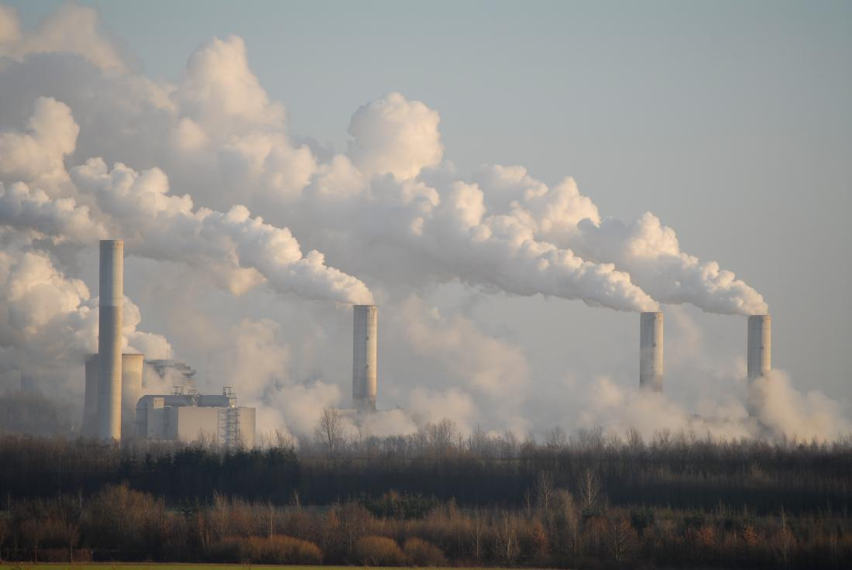
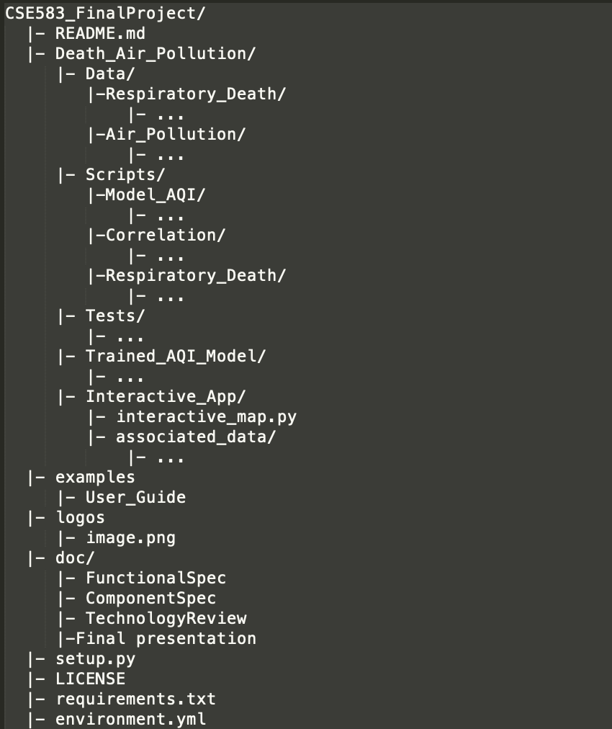
Github Repo Structure
Notes:
Brandon

Slide 16
Future Work
Lessons learned:
Write your tests earlier and make sure they pass continuous integration, and not just locally
Setup Github repo with the correct structure from the beginning
Write code in accordance to pylint requirements from the start
Future work:
Update the model with new air pollution data once the EPA publishes it
Explore more correlations between death rates and air pollution
Ex: monthly as opposed to yearly; past air pollution and current death rates
Notes:
Marta

Slide 17
Thank You!
Question?

